Slide 1
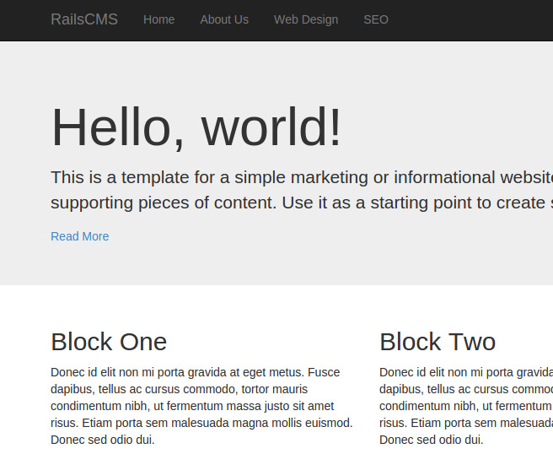
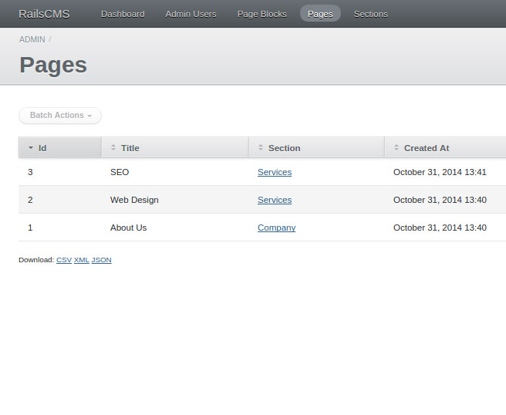
Projects Using Ruby on Rails
Project 4 Intro – Rails CMS

Slide 2
Project Description & Features
Backend using Active Admin
Easy resource management
Pages, sections, blocks and users
Frontend website
MySQL database
Bootstrap-sass layout
Dynamic navigation

Slide 3
Project Sections
Section 1: Project Introduction
Section 2: Application & Database Setup
Section 3: Active Admin – Part 1
Section 4: Active Admin – Part 2
Section 5: Frontend Pages & Menu
Section 6: Frontend Blocks

Slide 4
What You’ll Learn
Active Admin fundamentals
MVC framework fundamentals
CRUD operations in Active Admin
Bootstrap-Sass Gems for frontend
Admin namespace
Dynamic navigation

Slide 5
Let’s Do It!
Let’s go code!

